Slide 1
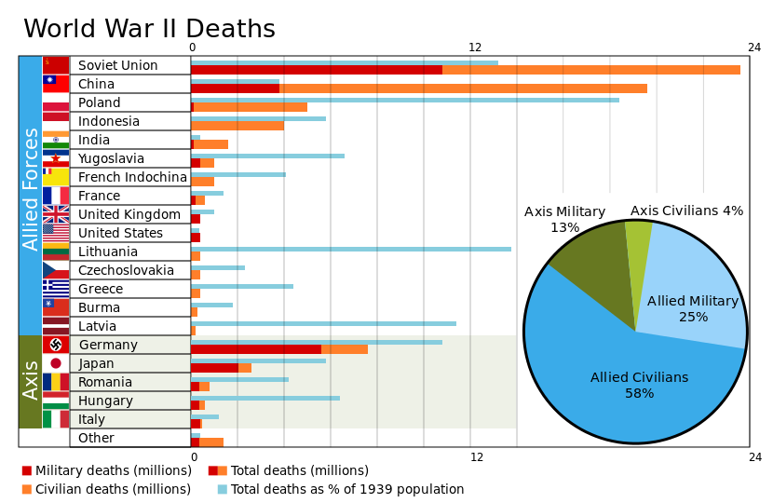
World War II
The European Course

Slide 2
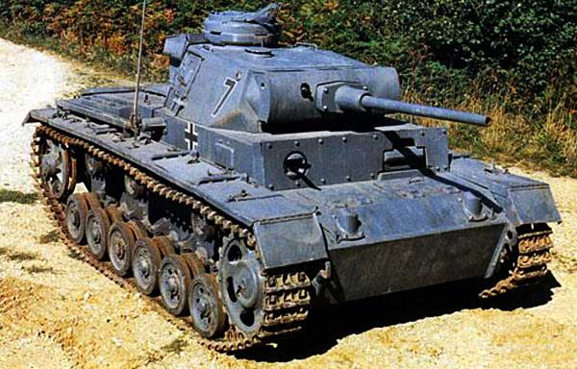
The Beginning
WWII begins when the Nazi blitzkrieg invades Poland from the West while the Soviets invaded from the East
Although Britain promised support they were incapable of getting troops into Poland
USSR takes Estonia, Latvia and Lithuania (Baltic states) as well as Finland

Slide 3
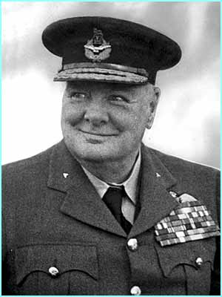
Denmark and Norway
Hitler then moves on to Denmark and Norway
Why was Norway important for Germany?
Swedish Iron Ore
Result: Neville Chamberlain is replaced by Winston Churchill

Slide 4
Churchill’s first speech as Prime Minister
"I would say to the House, as I said to those who have joined this Government, I have nothing to offer but blood, toil, tears and sweat. We have before us an ordeal of the most grievous kind. We have before us many long months of toil and struggle.
"You ask what is our policy. I will say, it is to wage war with all our might, with all the strength that God can give us, to wage war against a monstrous tyranny never surpassed in the dark, lamentable catalogue of human crime.
"You ask what is our aim? I can answer in one word: Victory. Victory at all costs. Victory in spite of all terror. Victory however long and hard the road may be. For without victory there is no survival."
First speech as Prime Minister, House of Commons, 13 May 1940

Slide 5
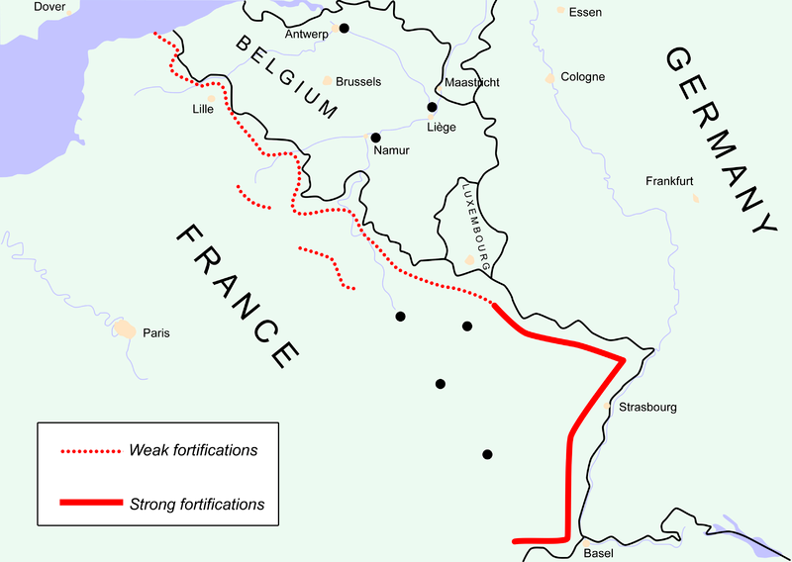
The Blitzkrieg rages on
May-June ‘40
Hitler attacks Belgium, Holland and then roles into France on May 12th.
Paris captured on June 14th.
300,000 plus British soldiers escape by way of Dunkirk (Operation Dynamo)

Slide 6
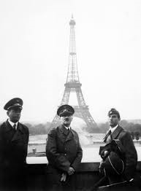
Nice job France
http://www.youtube.com/watch?v=003iC7VZmYc

Slide 7
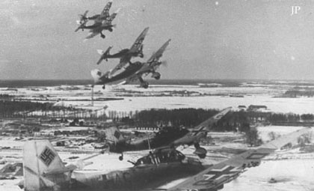
Battle of Britain
After France fell in just under six weeks to the Nazi’s, Great Britain was the only major power left to stand up to Hitler.
Hitler actually offered a favorable peace agreement to Great Britain.
The Luftwaffe was able to gain air superiority over the Royal Air Force
London Blitz

Slide 8
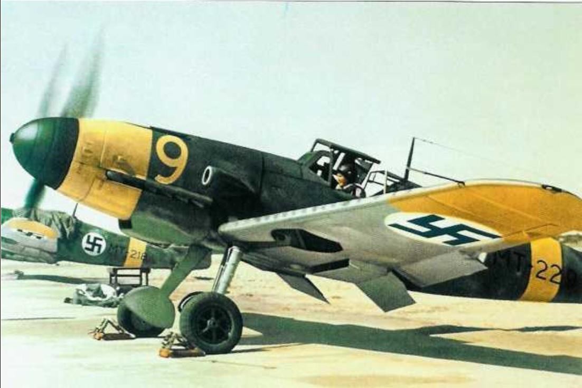
Why was Great Britain able to survive?
Geography
German bombers were vulnerable once their shorter range fighters had to return home
Messerschmitt Bf 109
Radar
Hitler bombs cities instead of RAF airfields

Slide 9
Results of the Battle of Britain
This represented the first time Hitler was not able to gain his objective
Churchill puts pressure on FDR to help G.B.
Hitler's failure to take Britain will later allow a launch pad for the allies to retake France in 1944

Slide 10
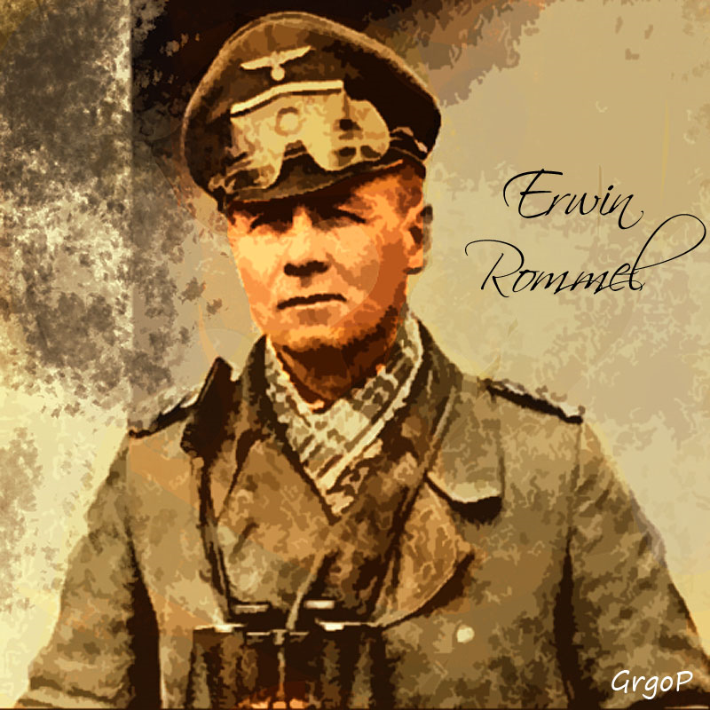
Significance of the Mediterranean and the Balkans
Set backs for the Allies
British troops had to go fight in North Africa and Greece
Hitler couldn’t invade USSR until six weeks later
North Africa would be the first place American soldiers would land in the European theatre

Slide 11
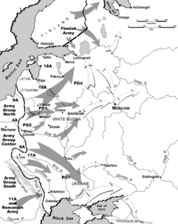
Operation Barbarossa
Hitler's motivations:
Hitler tries to fulfill Lebensraum
Desire for USSR oil
Eliminate Slavs and Communists
Quell Stalin’s territorial gains
Strategy:
North=Leningrad
Middle=Moscow
South=Ukraine/Caucuses (Oil)

Slide 12
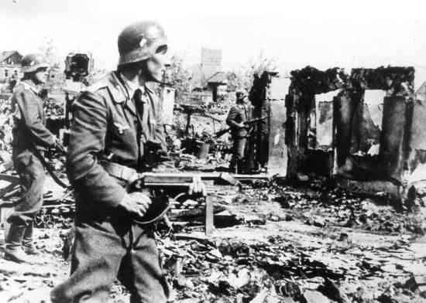
Why were the Soviets able to defeat The German Army?
Germans thought it would be a swift battle
Out ran their supply line
Hitler becomes commander
Germans could not replace tanks or other weapons
Russian female snipers
Use of radios in tanks and aircraft (Historian Richard Overy)
Stalin wasn’t making decisions
Patriotism
USSR loses ¾ of iron ore, coal and steel, ¼ of its railway and 40% of its electricity

Slide 13
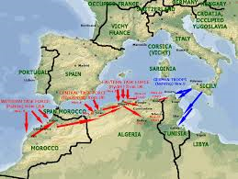
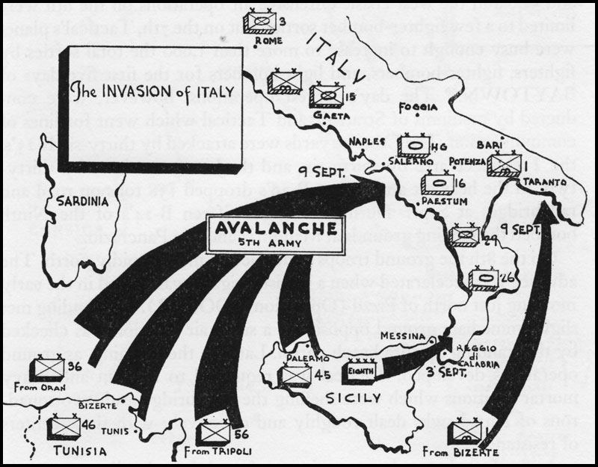
Operation Torch
Significances:
Prevented the Suez canal from falling to Hitler
Experience for Allies in large scale invasion
Launch pad for Italy
Invasion of Italy
Fascism ends in Italy April ‘45
Tied down German divisions
Improved relations with Stalin

Slide 14
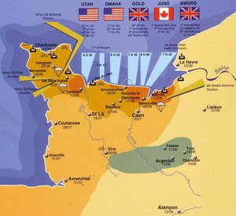
Operation Overlord
Planning for D Day began at the Tehran Conference (Nov-Dec 1943)
On June 6, 1944 326,000British, Canadian and American troops landed on Normandy (Gold, Juno, Sword, Omaha and Utah beaches)
Within a month most of Northern France was liberated
The Nazi’s were able to defeat the allies at Siegfried and also during the Battle of the Bulge (Ardennes)
Allies eventually cross through the Rhine on March 1945
April 30, 1945: Hitler swallows a bullet (May 7, 1945, VE Day)

Slide 15
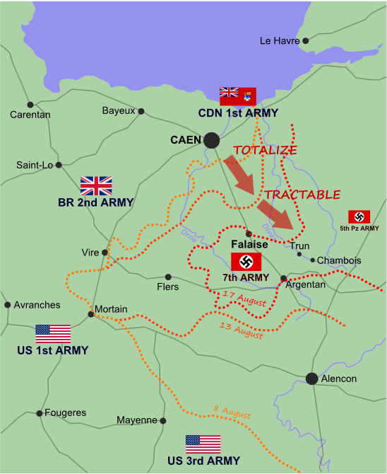
D Day facts
Invasion of Normandy (D-day) until now is the largest sea invasion in history, with almost three million troops crossing the English Channel from England to France that was occupied by Nazi Germany.
Invasion of Normandy opened with a parachute and glider landings in the early morning, the sea air and artillery attacks, and amphibious landings morning, on June 6, D-Day.
Battle for control of Normandy continued for more than two months, with campaigns to break through German lines and spread from coast Allies already controlled. The invasion ended with the liberation of Paris, and the fall of the Falaise pocket in late August 1944.
Approximately 6900 marine vehicles, including the 4100 Lander vehicle, used for the D-Day invasion, led by Admiral Bertram Ramsay.
In the D-Day invasion, 12,000 aircraft, including 1,000 paratroopers aircraft carrier, 10,000 tons of bombs will be dropped into the German defense, and aircraft will conduct 14 000 attack missions.
http://www.history.com/videos/d-day-deception#allied-advance-stalls-at-normandy

Slide 16
Work Cited
http://upload.wikimedia.org/wikipedia/commons/thumb/f/f1/World_War_II_Casualties2.svg/830px-World_War_II_Casualties2.svg.png
http://www.fiddlersgreen.net/vehicles/Panzer-PzIII-Tank/IMAGES/Panzer-III-WWII-Nazi-Tank-Title.jpg
http://news.bbc.co.uk/olmedia/1715000/images/_1719931_churchill_gall.jpg
http://www.winstonchurchill.org/learn/speeches/quotations
http://upload.wikimedia.org/wikipedia/en/archive/d/db/20111126142107!Adolf_Hitler_in_Paris_1940.jpg
http://4.bp.blogspot.com/-rgiYD8L7P5M/Tt0OtipKFmI/AAAAAAAAPhE/O-fWIfNF5xA/s1600/Luftwaffe.jpg
http://upload.wikimedia.org/wikipedia/commons/d/d7/Messerschmitt_Bf_109G-2.jpg
http://madmikesamerica.com/wp-content/uploads/2012/08/erwin_rommel_the_desert_fox_by_grgo1408-d4qu1om.jpg
http://upload.wikimedia.org/wikipedia/commons/thumb/3/36/Operation_Barbarossa_corrected_border.png/250px-Operation_Barbarossa_corrected_border.png
http://www.toptenz.net/wp-content/uploads/2011/08/Stalingrad.jpg
http://th02.deviantart.net/fs71/300W/i/2012/154/2/8/world_war_2__operation_overlord_by_titanicfan1000-d525zu6.jpg
http://www.dailyworldfacts.com/d-day-facts/

