Slide 1
Rise of Democracy
“The political activity that pervades the United States must be seen in order to be understood. No sooner do you set foot upon American ground than you are stunned by a kind of tumult”—Alexis de Tocqueville (Democracy in America, 1835)

Slide 2
Change in Politics
Voter turnout increases vastly from 1824-1840
Reasons why
Universal White male Suffrage
New states like Illinois, Missouri and Indiana had no religious or property restrictions on voting
Party nominations
Elimination of the “King Caucus”
Replaced with national conventions

Slide 3
Change in Politics Continued
3. Two party system
National election campaigns
4. Third Parties
Democrats and Whigs were the two biggest parties but groups such as the Anti-Masonic party and the Workingmen’s party appealed to the “common man”
5. More elected officials were open to voters instead of appointment

Slide 4
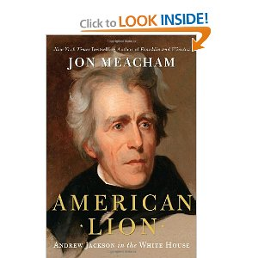
The Revolution of 1828--The Age of Jackson
The only President with an era named after himself

Slide 5
Spoils System
Pres. Jackson believed in appointed political supporters to gov’t jobs
Example—Postmaster General
Often referred to as political patronage
Jackson also believed in political rotation
This would maximize the number of Democrats in office
He claimed it was a democratic reform
“No man has anymore intrinsic claim to office than another.”
http://www.schooltube.com/video/bad061dacabe449884f5/Andrew%20Jackson%20by%20Shmoop

Slide 6
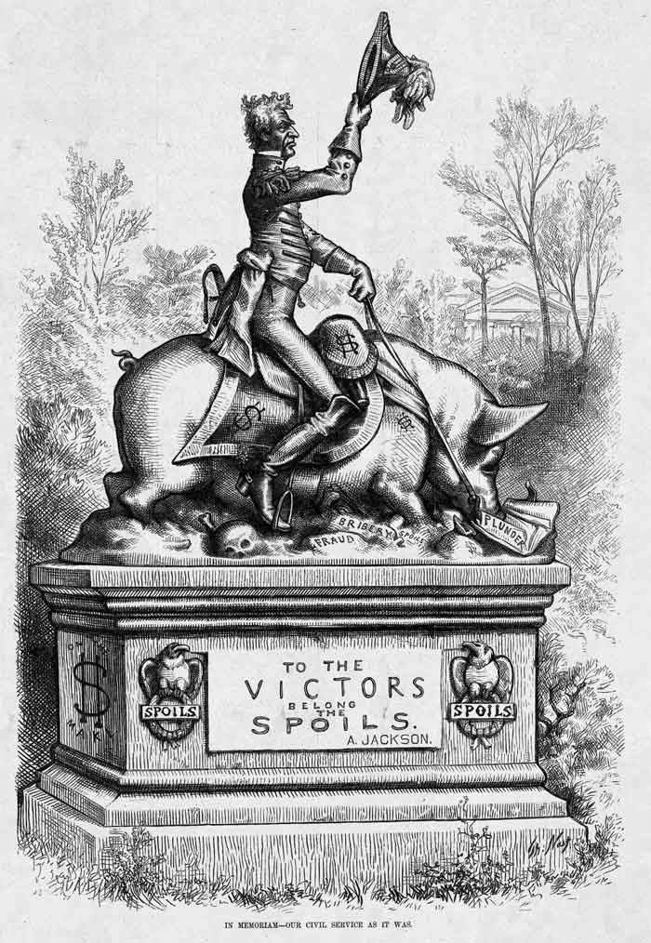

Slide 7
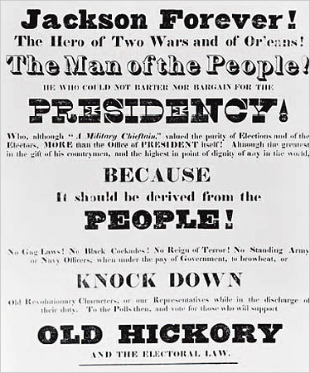
Election of 1828
3x the amount of voters participated in 1828 than in 1824
1st mudslinging campaign
Adams’ wife was born out of wedlock
Jackson’s wife was an adulterous whore
President Adam’s accused of misappropriation of funds by purchasing gambling devices (In reality he bought a chessboard and a pool table)
Jackson was accused of murder for executing militia deserters and dueling

Slide 8
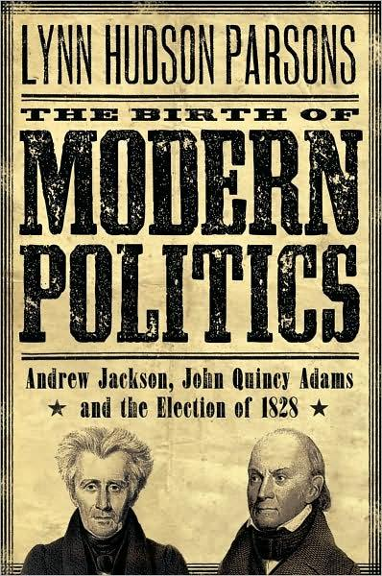
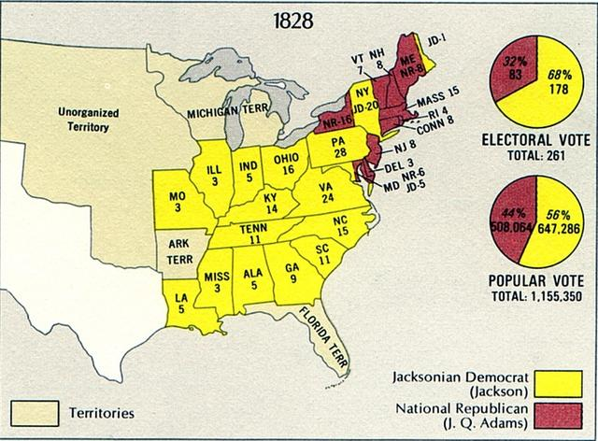

Slide 9
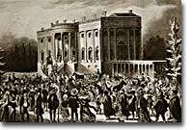
“Young Hickory” take charge
Day 1
Inauguration bash
“Champion of the common man”
Vetoed more bills than all other previous Presidents combined
Example: Maysville Road veto (Kentucky)

Slide 10
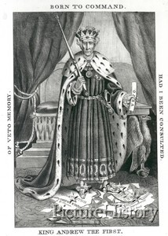

Slide 11
Peggy Eaton Affair
Secretary of War’s wife (Peggy Eaton) was refused invitations to parties because they expected her of being an adulteress
Jackson mandated that his cabinets wives associate themselves with Mrs. Eaton
Results:
Most, including VP Calhoun resign
“Kitchen Cabinet”

Slide 12
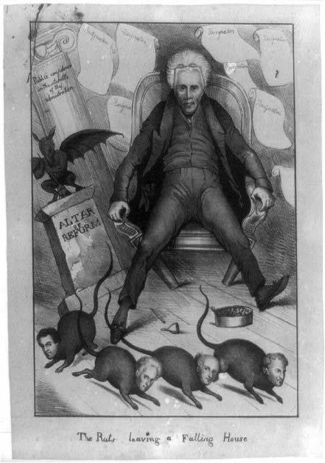

Slide 13
Nullification Crisis
For the most part Jackson was a believer in states rights
1828—S.C. declares the Tariff of 1828 to be unconstitutional (Tariff of Abominations)
Nullification Theory--Calhoun decided that each state could decided whether to follow or void a federal law
In 1832 Calhoun held a special convention forbidding the collection of Tariffs
http://www.youtube.com/watch?v=8L6eYZs1tDo

Slide 14
General Jackson responds
Force Bill—Jackson asks and receives a resolution asking for the use military force
Henry Clay steps in and lowers the tariff
Webster Hayne debate
1830 Daniel Webster (Mass) and Robert Hayne (S.C.) debate over state vs. federal right
http://www.youtube.com/watch?v=OU4X_xphee8

Slide 15
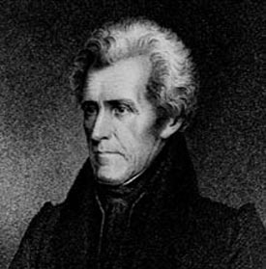
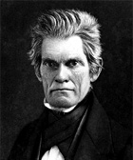
“Our Federal Union, it must be preserved”
“The Union, next to our liberties, Most Dear!”

Slide 16
Indian Removal Act
The President of the common man decides that the safest route was for Native Americans to move west of the Miss. River so whites could smoothly acquire their land
Georgia passed a law requiring the Cherokees to move
Supreme Court cases:
Cherokee vs. Georgia
Worcester vs. Georgia
http://www.youtube.com/watch?v=pNZSpsMqNKo

Slide 17
Outcome
“Chief Justice John Marshall has made his decision, now let him enforce it.”
Is this Constitutional?
Trail of Tears
Treaty of New Echota gave Jackson the legality to move the Cherokees
Beginning in 1838 (under Van Buren) the Cherokee are forced to endure the “Trail of Tears”
15,00 forced to move West, 4,000 perish along the way

Slide 18
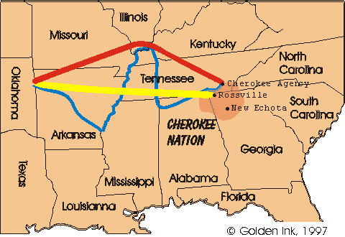
Route that resulted in thousands of Cherokee deaths

Slide 19
Painting by Robert Lindneux
http://www.youtube.com/watch?v=Np-TYoZE5NM

Slide 20
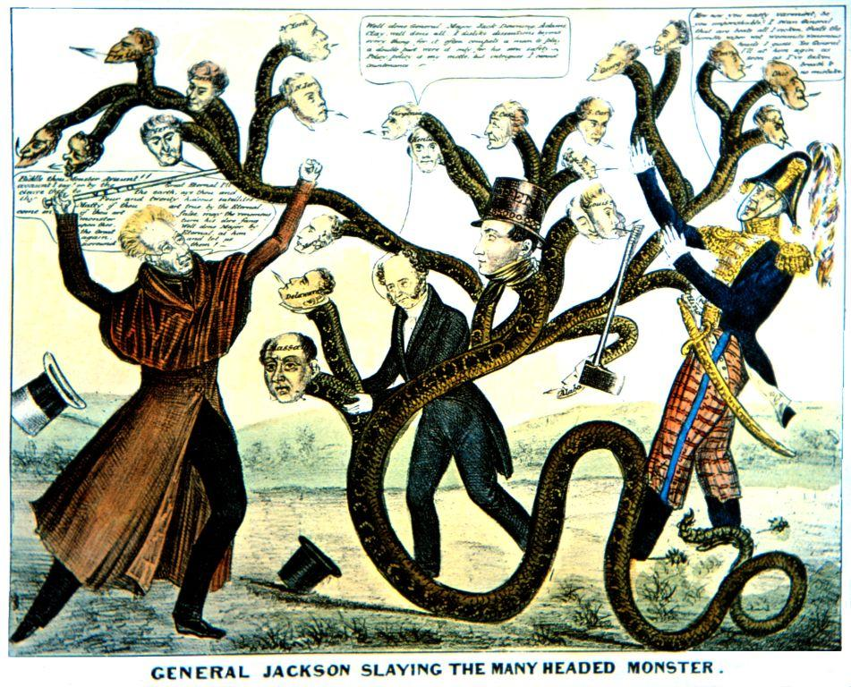
"The Bank is trying to kill me, Sir, but I shall kill it!"
In, Nicholas Biddle's supporters in Congress, principally Daniel Webster and Henry Clay, introduced Bank recharter legislation
Jackson vetoed the Bank Recharter Bill
Jackson also ordered the federal government's deposits removed from the Bank of the United States and placed in state or "Pet" banks
Results?
“Pet Banks”
Specie Circular
The Bank War

Slide 21
Did you know
Old Hickory really earned his nickname. Not only was Jackson as unbending as a tree, but also as tough as wood. In battle he was shot in the arm, but refused to have it amputated, the only way in that time to treat wounded arms and legs. Instead, he chose the healing art of a Cherokee medicine man and kept his arm.

