Slide 1
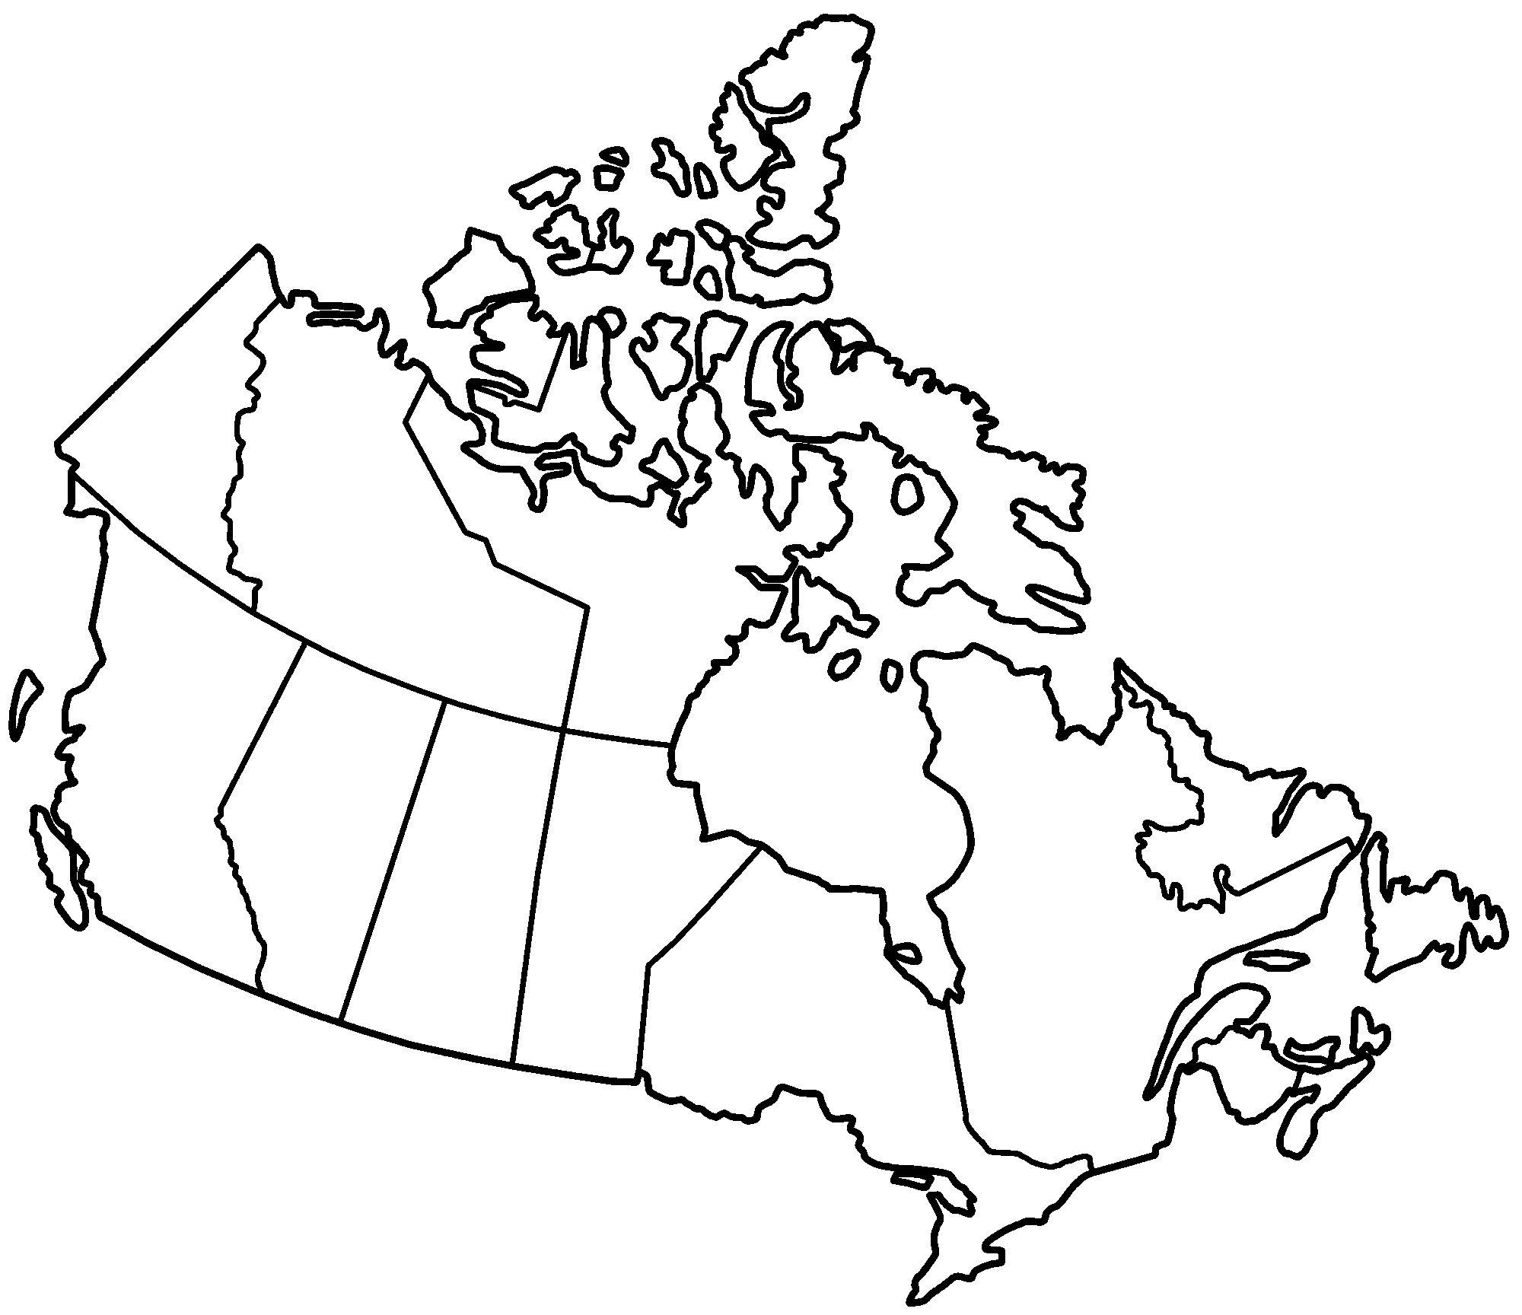
Name __________ Please label all 10 provinces

Slide 2
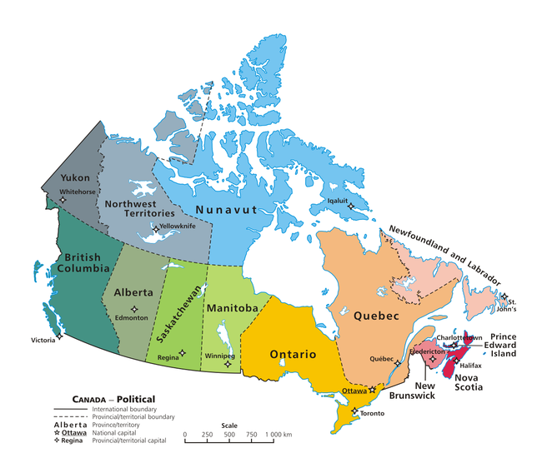
Answer Key

Slide 3
Canada Provinces
Québec
Ontario
British Columbia
Alberta
Nova Scotia
Manitoba
Saskatchewan
New Brunswick
Prince Edward Island
Newfoundland and Labrador

