Slide 1
Question
Which of the following caused the other four?
Jay’s Treaty
French Revolution
XYZ affair
Citizen Genet
Washington’s Proclamation of Neutrality

Slide 2
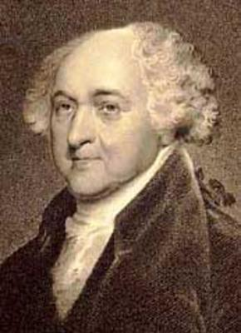
John Adams
1797-1801

Slide 3
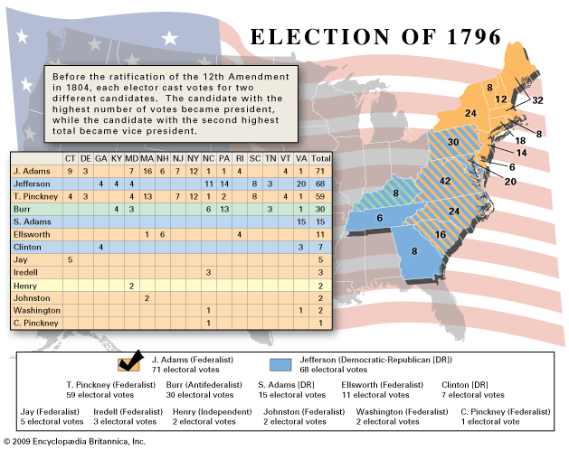

Slide 4
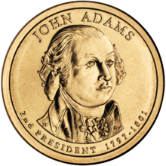
Foreign Problems
Troubles abroad during the French Revolution lead to problems that President Adams was forced to try and solve

Slide 5
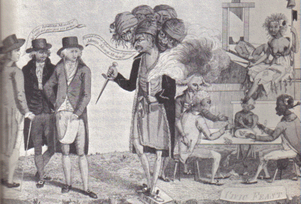
XYZ Affair
French were seizing (impressing) American ships
Delegates were sent to France to negotiate a peace
3 French agents (nicknamed XYZ) requested a bribe prior to negotiations
Alexander Hamilton hoped for war thinking the US could gain French and Spanish possessions in N. America

Slide 7
Quasi War
Undeclared naval war between the US and France
1798-1800
1800 France and the US mutually agree to terminate their previous alliance
The United States would not enter into another formal alliance for another 150 years

Slide 8
Alien and Sedition Acts
Naturalization Acts
14 years to become a citizen
Alien Acts
Pres. Could deport or detain any aliens considered dangerous
Sedition Acts
Newspapers couldn’t criticize the Pres. or Congress

Slide 9
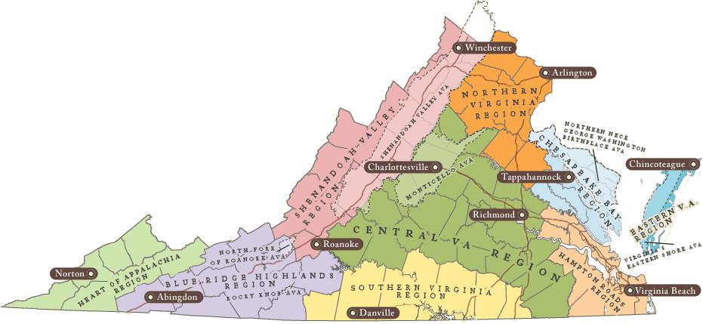
VA and KY resolutions
These resolutions said the states entered a compact in forming the national gov’t. These resolutions brought the theory that states could nullify any unjust federal laws

Slide 10
Where does President Adams rank?
According to several Presidential Historians John Adams usually ranks as the ninth best President and as low as the seventeenth best President. Usually he falls in the 11-13 range.

