Slide 1
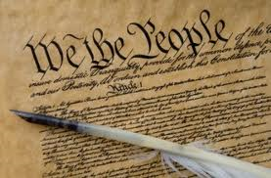
Compromises
PowerPoint presented by Mr. Shepard
of the Constitution

Slide 2
What is a compromise?

Slide 3
3/5 Compromise
Continued debate over slavery
North –V- South
South wants slaves counted for representation in the House but didn’t want them counted for taxes
Comprise= three fifths of enslaved African Americans counted
Taxes and representation

Slide 4
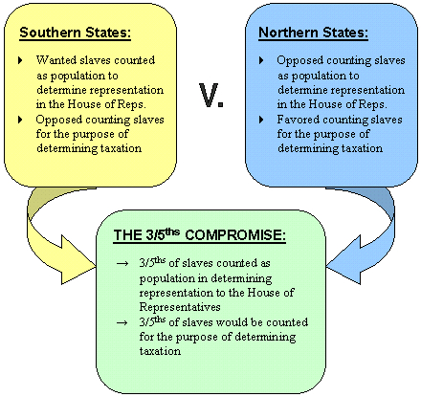

Slide 5
The Great Compromise (Connecticut Compromise)
Solved the problem of representation in Congress
Congress=Bicameral
Each state would now have 2 members in Congress
H.O.R. =each state would receive representatives based on population

Slide 6
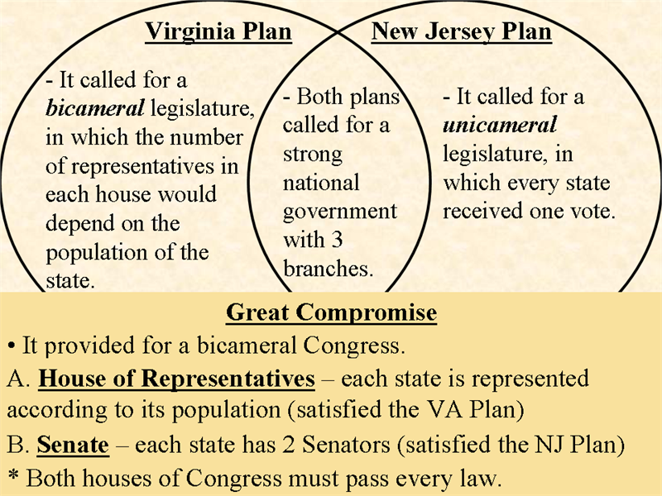

Slide 7
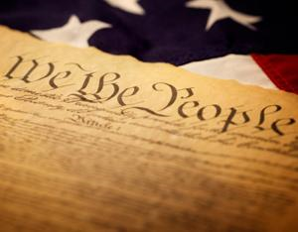
Bill of Rights
Federalists
Favored a strong government
Supported the Constitution
Anti-Federalists
Feared a strong government would deny people of their rights
Opposed the Constitution

Slide 8
B.O.R.
Federalists | Anti-Federalists
Handle the country’s problems | No Bill of Rights
Provide order and stability | Strong government
Protect the country | Deny people rights
Provide the separation of powers | Overrule state laws
System of checks and blances | Favored the wealthy

Slide 9
Commerce Compromise
Congress could not tax exports
Congress could regulate tax
President given powers to make treaties with other countries

