Slide 1
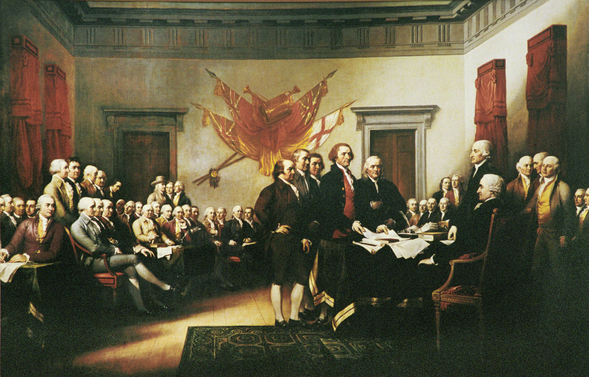
Colonial path to independence
A brief timeline of events

Slide 2
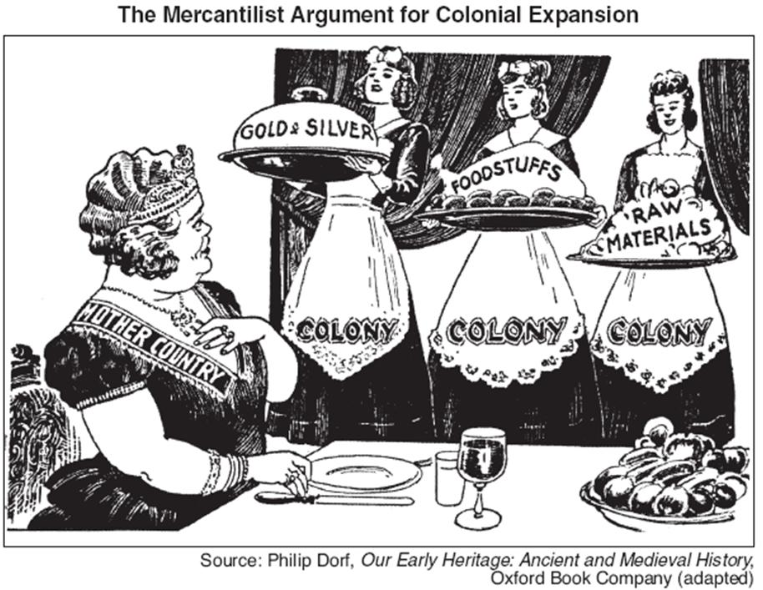

Slide 3
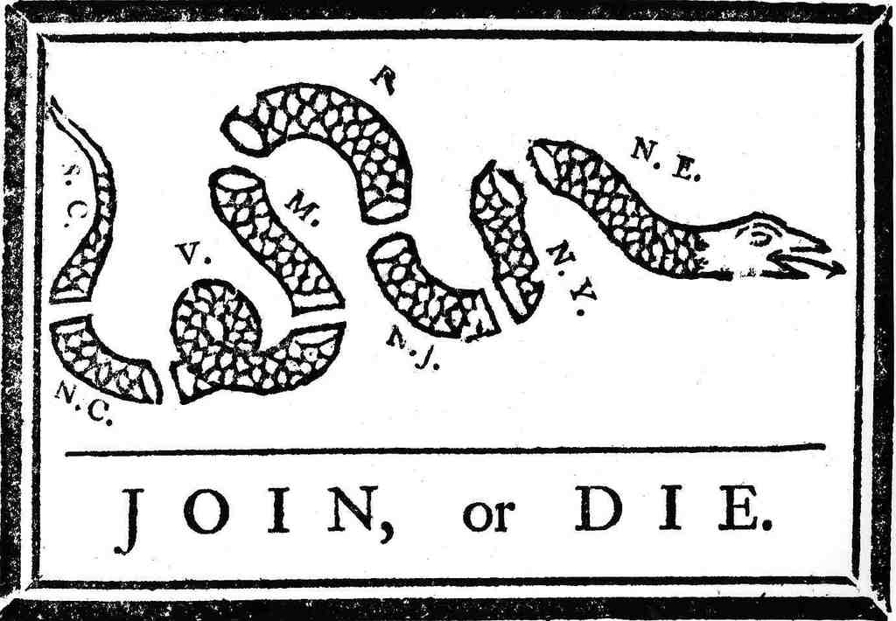
Albany Plan of the Union
The Albany Plan of Union was a plan to place the British North American colonies under a more centralized government. The plan was adopted on July 10, 1754, by representatives from seven of the British North American colonies. Although never carried out, it was the first important plan to conceive of the colonies as a collective whole united under one government.

Slide 4
Salutary Neglect
Period beginning in the 17th century and ending in the 18th century where England basically left the colonies to themselves

Slide 5
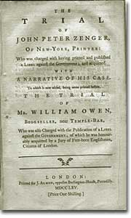
John Peter Zenger
Case allowed the precedent of freedom of the Press

Slide 6
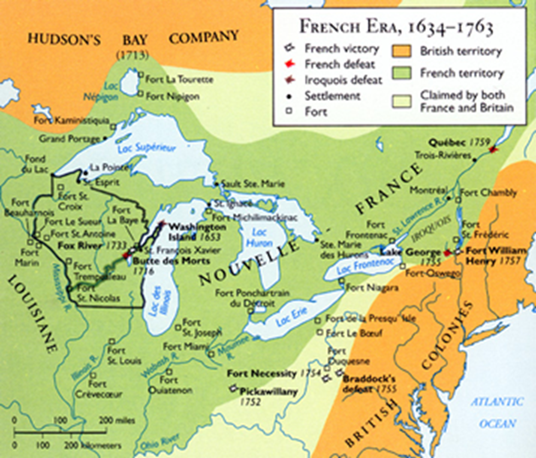
French and Indian War
After the British and the colonists defeated the French and Natives, Great Britain began taxing the colonies in order to create revenue

Slide 7
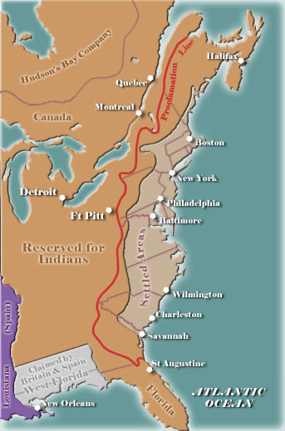
Proclamation of 1763
After the French and Indian War Great Britain restricted the colonists from moving West of the Appalachian Mts.

Slide 8
Sugar Act
First tax that Great Britain placed on the colonies in order to pay for the French and Indian War. The colonists responded by smuggling Sugar from French colonies (Britain's main competition)

Slide 9
Stamp Act
Great Britain made the colonists pay a tax on anything paper

Slide 10
Declaratory Act
Great Britain had the right to pass any laws regarding the colonies

Slide 11
Townshend Act
Another way Great Britain created revenue by imposing a tax on glass, paint, lead and tea.

Slide 12
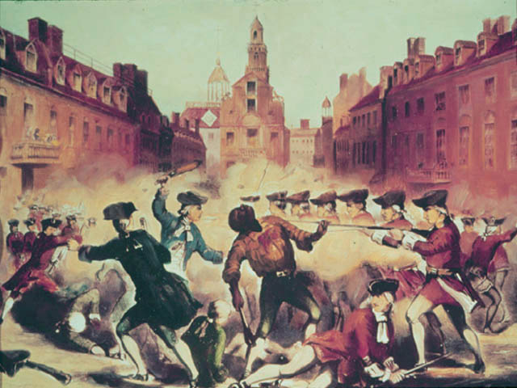
Boston Massacre
March 5, 1770, five colonists were killed by armed British soldiers, who had been living in the colonies since the start of the start of the French and Indian War.
Was this truly a massacre?

Slide 13
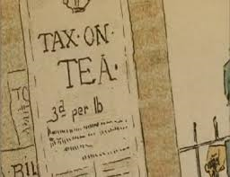
Tea Act
The British government decided to regulate where the colonists could purchase tea from. They were only allowed to purchase tea from the British East India Company.

Slide 14
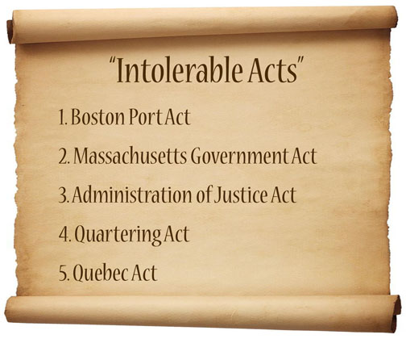

Slide 15
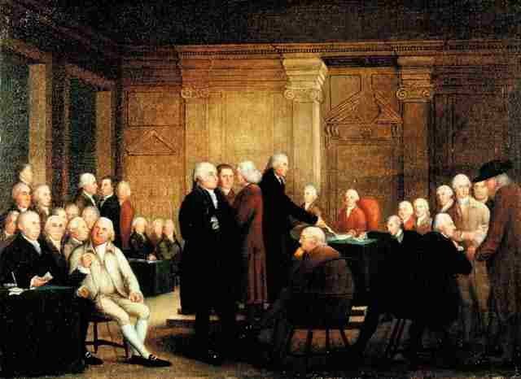
First Continental Congress
First meeting of all thirteen colonies where they sent a letter of grievances to King George

Slide 16
Second Continental Congress
Established in 1775 after Lexington and Concord
2nd Continental Congress began to militarize in case war became inevitable against Britain.

Slide 17
Common Sense
Pamphlet written by Thomas Paine (British Citizen stating that it was time for the colonies to break away from England.

