Slide 1
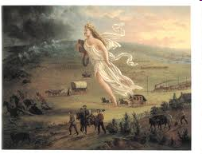
America Moves West
“Our manifest destiny is to
overspread the continent
allotted by Providence for the
free development of our yearly
multiplying millions”
-John O’Sullivan, 1845

Slide 2
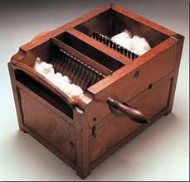
Why move West?
Nationalism
Population increase
Economics
Technology
Why would people be opposed to Westward migration?

Slide 3
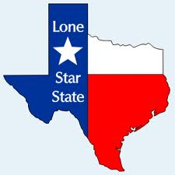
Texas
Stephen Austin brought 300 US families to Texas
By 1830 US families outnumbered Mexican families 3-1
1829-Mexico outlaws slavery and required all settlers to convert to Catholicism
1834-Santa Anna becomes dictator of Mexico
Under Sam Houston, Texas declares independence in 1836

Slide 4
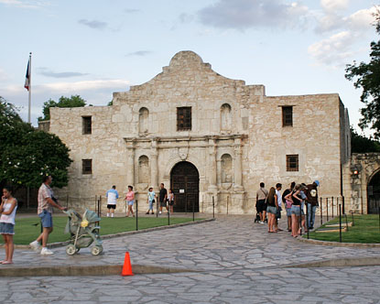
The War
Santa Anna attacks the Alamo, thus killing every defender
Sam Houston later captures Santa Anna and forces him to recognize Texas’ independence
President Houston asks the US to annex Texas in 1836 but Presidents Jackson and Van Buren deny Texas’ request

Slide 5
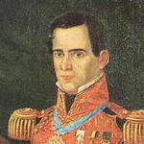
Santa Anna would be forced under threat of execution to grant Texas its independence in 1836

Slide 6
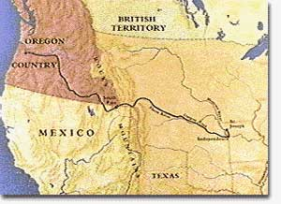
Oregon
Conflict between the British and American settlers begins in 1846 in large part because of profitable fur trade
Many Americans had “Oregon Fever”
5,000 Americans flocked to Oregon to help settle the area

Slide 7
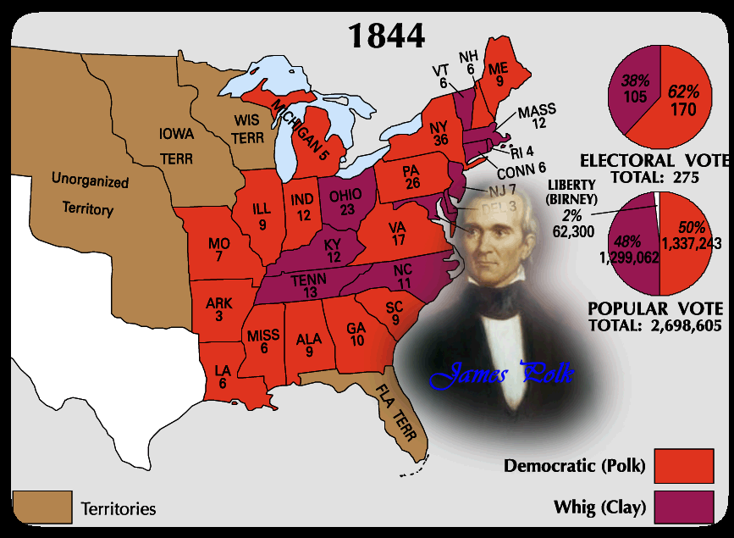
Election of 1844
“Fifty Four Forty or Fight!!!”

Slide 8
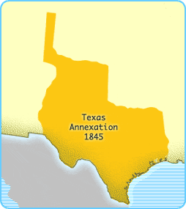
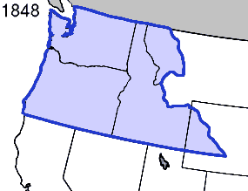
Annex Texas and Dividing Oregon
Outgoing President Tyler persuaded Congress to pass a resolution annexing Texas
Polk compromised with Britain and decided to split Oregon at the 49th parallel.

Slide 9
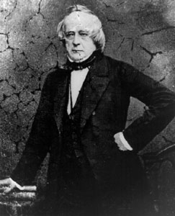
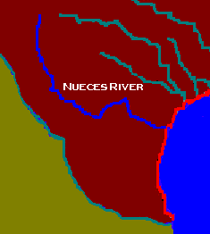
Mexican American War
President Polk ordered John Slidell to Mexico City to:
Buy California and New Mexico Territories from Mexico
Settle a dispute between Mexico and Texas

Slide 10
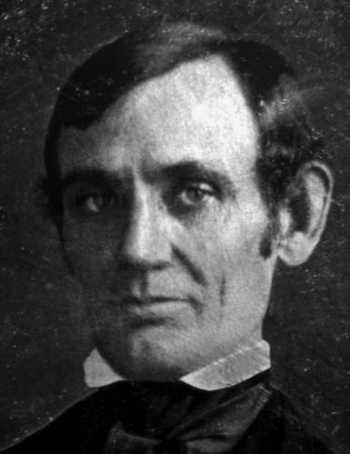
The War
Gen. Zachary Taylor was ordered to move his army towards the Rio Grande
‘46 the Mexican Army crossed the Rio Grande capturing n American patrol
This allowed Polk to gain a declaration of war
Congressmen Lincoln thought that this opposed going to war

Slide 11
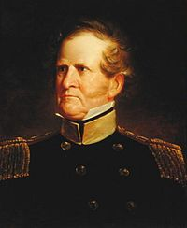
Military Campaigns
Gen. Stephen Kearney captured Santa Fe
John C. Fremont overthrew Mexican rule in Northern California
Polk chooses Winfield Scott to invade Mexico, capturing Mexico City an 1847

Slide 12
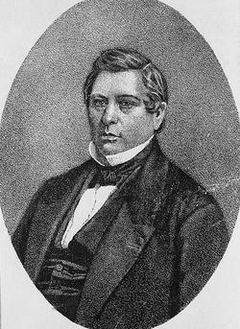
Consequences of the Mexican American War
Guadalupe Hidalgo (Mexican Cession)
Rio Grande border
US gain California and New Mexico for $15 million
Wilmot Proviso
Forbid slavery in territories acquired from Mexico
(Passed House twice and was defeated inn the Senate)
David Wilmot

Slide 13
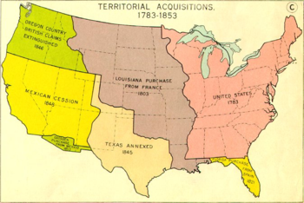

Slide 14
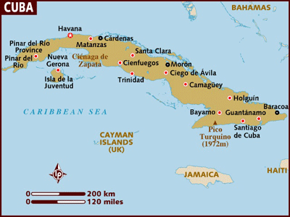
Destiny in the South
Ostend Manifesto
Polk offered to buy Cuba from Spain for $100 million
Spain refuses
This would have helped keep a balance of free and slave states

Slide 15
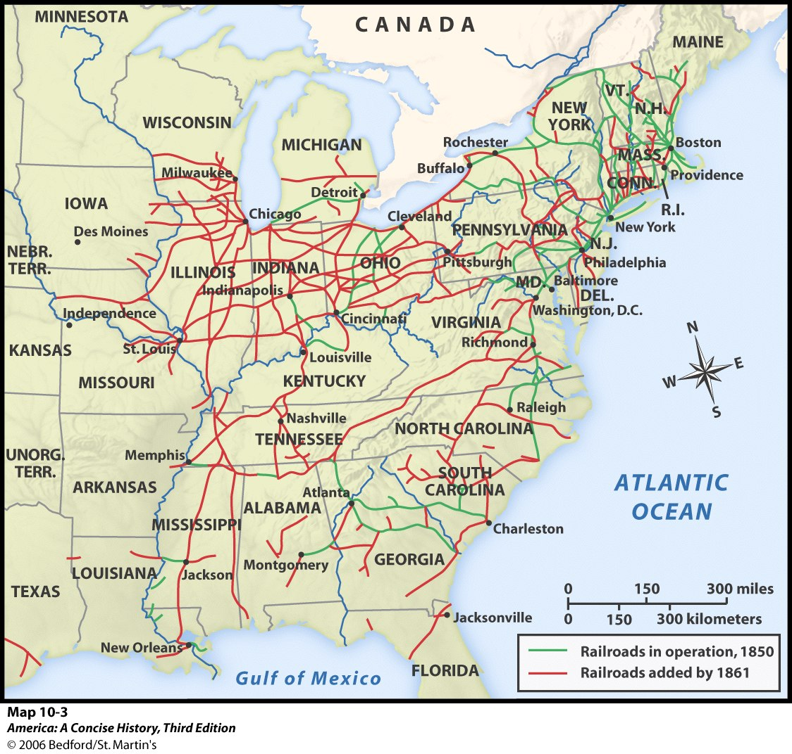
Explosion of Industry
Railroads (1840s-’50s)
Replaced canals as the main form of transportation
Steamships
Commodore Matthew Perry goes to Japan in 1854

Slide 16
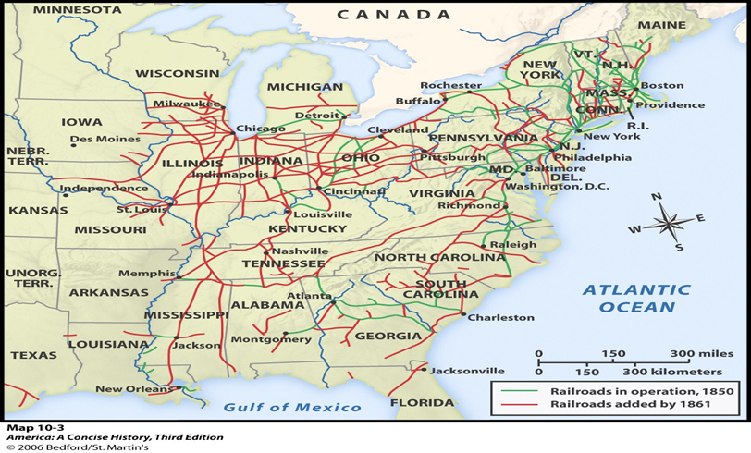

Slide 17
Panic of 1857
http://www.youtube.com/watch?v=fmnfRJ8hSB0
Looking ahead:
What impact did this have on the South’s decision to secede from the union?

